Slide 1
Face Mask Detection
Team No: 36
Name: Divide & Conquer
Members:
>> Sree Chand
>> Xitiz Verma
>> Sri Goutham J

Slide 2

PROBLEM STATEMENT WE CHOSE IN OUR HACKATHON:
In the current covid crisis, we all know how important it is to have a mask on, especially in the public places. We have seen in most of public places there is always human resource used to check if the people are wearing a mask or not.
It’s not ideal for a person to work round the clock, humans can get tired or over a period of time there efficiency can be down.
In order to overcome this very situation, we have come up with a face mask detection, ML model which detects weather a person has worn a mask or not

Slide 3
Training the model
The model is trained using tensorflow, with a dataset of over 1900 images of people with and without mask.
While training each of image is augmented to different angle of rotation, different view points, hence increasing the accuracy of the model when tested.
Collected the dataset from various open source websites like Kaggle.
Facial landmarks allow us to automatically infer the location of facial structures, including:Eyes, Eyebrows, Nose, Mouth, Jawline. To use facial landmarks to build a dataset of faces wearing face masks, we need to first start with an image of a person not wearing a face mask

Slide 4
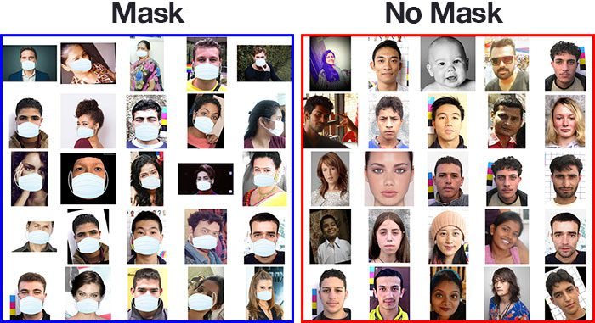
Our Dataset

Slide 5
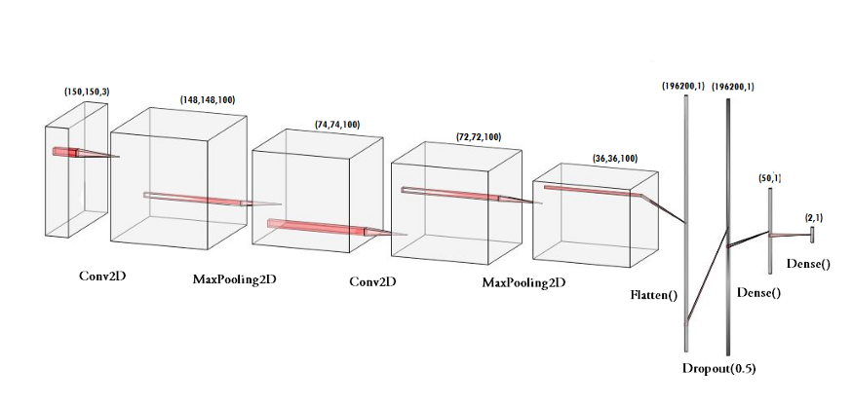
Working of the model

Slide 6
Machine Learning Libraries we Used
>TensorFlow – For training and forming Convolutional Neural Net Structure
>Keras – Deep Learning Python Library integrated into TensorFlow
>Imultis – Working With Images
>Numpy – Scientific Computing in Python , For working with Pixel Matrices as in Images
>OpenCV – For detecting Facial Structures like Eyes, Nose , Eyebrows , Lips, Smile etc.
>MatPlot – Plotting Graph for Loss and Accuracy Percentages in the given detection for Mask and No Mask Conditions
>Scipy – Data Preprocessing from Convolutional Neural Network Layers

Slide 7
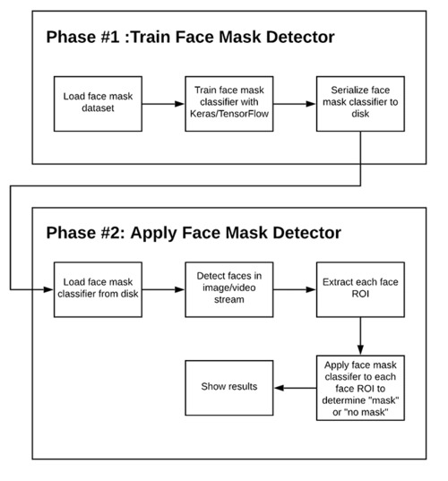
Flow Chart

Slide 8
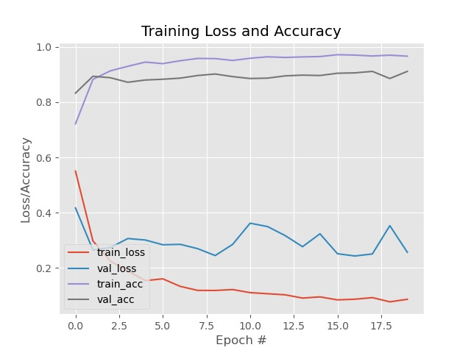
Our Model Accuracy

